Slide 1

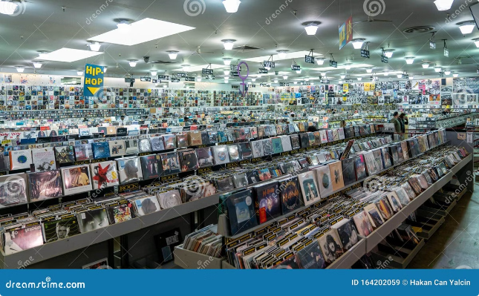

Music Store Analysis: Unlocking Growth Opportunities
This presentation delves into the comprehensive analysis of our music store's data, providing insights into customer behavior, product performance, and market trends. We will explore key findings that highlight opportunities for growth and revenue optimization. Through data-driven insights and actionable recommendations, this report aims to guide our business decisions and propel our music store towards greater success.
by shreeram kulkarni

Slide 2

CSV Files:
album
artist
customer
employee
genre
invoice
invoice_line
media_type
playlist
playlist_track
track

Slide 3
Steps:
Data cleaning
Perform sql queries to get answer of questions.
Insights for store.

Slide 4

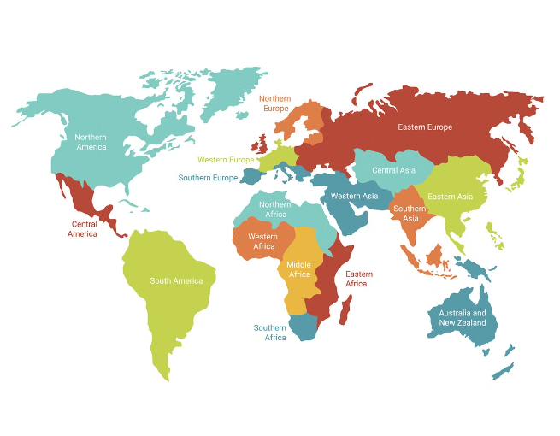
Geographic Sales Insights
USA Dominance
The USA stands out as our most lucrative market, generating 131 invoices, significantly higher than any other country. This indicates a strong customer base and potential for further expansion.
Prague: A Revenue Hotspot
Prague emerges as the city with the highest revenue generated. Understanding the factors contributing to this success could provide valuable insights for targeting other European markets.
Global Market Diversification
While the USA shows strong performance, exploring other regions like Canada and the UK with potential for growth is crucial. Identifying customer preferences and tailoring marketing strategies accordingly will be key.

Slide 5



Customer Segmentation and Loyalty
1
Customer ID 5: The Premier Patron
Customer ID 5 stands out as our highest-spending customer. Understanding their preferences and purchase history provides a template for building a loyal customer base.
2
Top Customers per Country
Identifying top-spending customers in each country like František, Helena, and Hugh allows for targeted marketing efforts and tailored promotions.
3
Customer Segmentation Strategies
Developing a comprehensive customer segmentation strategy based on spending habits, genre preferences, and purchase frequency will enable us to personalize marketing campaigns and increase customer engagement.

Slide 6
Music Genre Performance and Demand
Rock Music: The Dominant Force
AC/DC: A Rock Icon
Genre-Specific Marketing
AC/DC stands out as the artist with the highest rock music output in our dataset, suggesting a strong fan base and potential for targeted promotions.
Tailoring marketing campaigns and product recommendations based on genre preferences will enhance customer satisfaction and drive sales. This requires a deep understanding of each genre's fan base.
Rock music reigns supreme across the USA, Canada, and the UK. This trend suggests a strong market demand for rock artists and a potential to further capitalize on this popularity.

Slide 7

Top-Performing Products and Trends
Metric
Value
Top 3 Invoice Values
23.75, 19.8, 18.81
Longest Tracks
'How Many More Times', '711836', 'Advance Romance', '677694', 'Sleeping Village', '644571'
Analyzing the top-performing products and trends provides insights into customer preferences and potential opportunities for expansion. Understanding what products contributed to the highest invoice values can guide future inventory decisions and marketing strategies. Promoting longer tracks to customers seeking in-depth musical experiences could cater to specific preferences.

Slide 8




Employee Performance and Leadership
Adams Andrew: Top Performer
Employee Development and Training
Performance Monitoring and Feedback
Adams Andrew holds the highest job title, L6, signifying strong leadership and expertise within the organization. Identifying and recognizing top performers like Adams is crucial for motivating and retaining talent.
Investing in employee development and training programs will enhance skills and foster a culture of continuous improvement. This leads to a more engaged and productive workforce.
Regularly monitoring employee performance and providing constructive feedback is essential for driving growth and ensuring accountability. This can be achieved through performance reviews and regular check-ins.

Slide 9






Actionable Recommendations: Driving Growth
Focus on the USA Market
Capitalize on the USA's strong performance by intensifying marketing and sales efforts in this region. This could involve targeted advertising campaigns, promotional offers, and events tailored to the American music market.
Promote Rock Music Across Key Markets
Leverage the popularity of rock music in the USA, Canada, and the UK by focusing marketing and programming efforts on this genre. This could include showcasing popular rock artists, offering genre-specific playlists, and hosting rock-themed events.
Cultivate Customer Loyalty
Implement loyalty programs, personalized recommendations, and exclusive offers for top customers like Customer ID 5. This will foster a sense of exclusivity and encourage repeat business.
Capitalize on Prague's Success
Investigate the factors contributing to Prague's high revenue generation and consider hosting a promotional music festival or concert series in this city to attract a wider audience and capitalize on the success of this market.

Slide 10


Strategic Partnerships and Collaborations
1
Artist Collaborations
Consider inviting popular rock artists like AC/DC and other top performers to headline events in Prague or other key markets. This will attract a large audience and generate significant buzz.
2
Music Industry Partnerships
Establish partnerships with music labels, distributors, and other industry players to expand product offerings, secure exclusive content, and gain access to new markets.
3
Community Engagement
Collaborate with local music schools, community organizations, and cultural institutions to organize events, workshops, and educational programs. This will build brand awareness and foster community engagement.

Slide 11
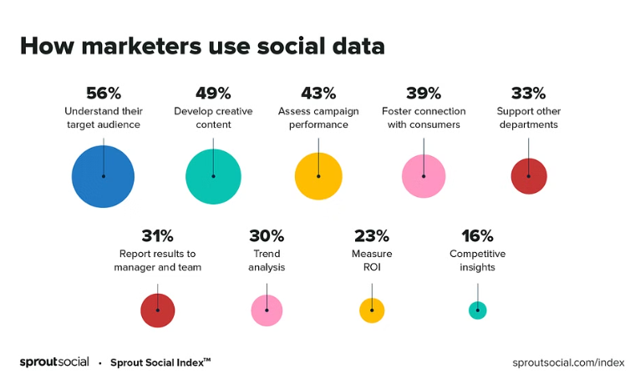

Digital Marketing and Online Presence
Social Media Marketing
Music Streaming Partnerships
Leverage social media platforms like Facebook, Instagram, and TikTok to reach a wider audience, engage with fans, and promote new releases, events, and special offers.
Partner with popular music streaming services like Spotify, Apple Music, and Amazon Music to make our music catalog accessible to a global audience and generate revenue from streaming royalties.

Slide 12
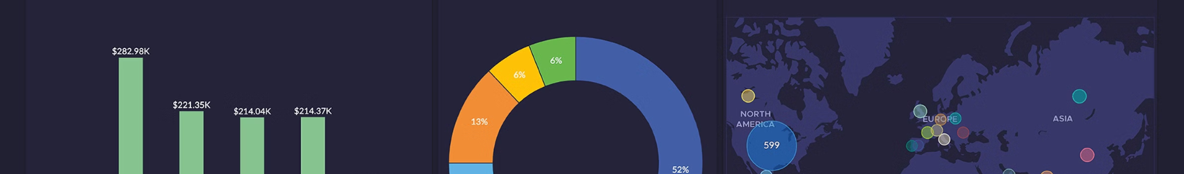
Continuous Data Analysis and Optimization
Regular Data Analysis
Implement a system for regular data analysis and reporting to monitor key performance indicators, track trends, and identify areas for improvement. This will allow us to make informed decisions based on real-time data.
A/B Testing and Experimentation
Utilize A/B testing and experimentation to optimize marketing campaigns, website design, and product offerings. This will allow us to continuously iterate and improve based on data-driven insights.
1
2
3
Customer Feedback
Actively seek customer feedback through surveys, reviews, and online interactions to understand their needs, preferences, and areas for improvement. This will allow us to refine our offerings and improve customer satisfaction.

